Slide 1
Using Dynamic Data Exchange for Malspam Distribution
Christopher Morcom

Slide 2
Overview
Question
Related work
Test Bench
Implementation Issues
Experiment
Future Progress
Current Inferences

Slide 3
How can we modify and distribute DDE attacks to infect hosts with botnets for exploitation and what are some defenses?

Slide 4
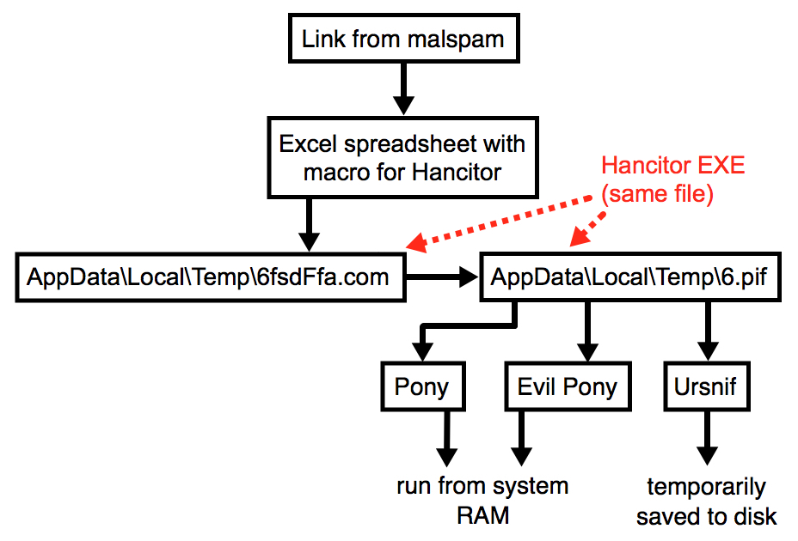
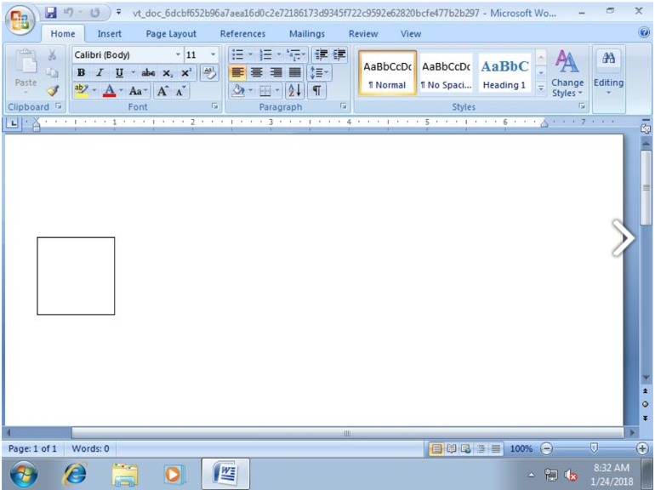
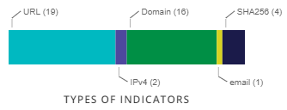
Hancitor Malspam
Phishing attack (binary)
Distributes Banking Trojans
USA and Canada Only
Social Engineering Attack
Notes:
Hancitor is a malspam (classified as a banking trojan) that uses DDE or MS Office Macros delivers malware families:
Pony
Zeus Panda Banker
Connects to a server to steal data
https://redcanary.com/blog/microsoft-dde-exploit-email/
https://www.malware-traffic-analysis.net/2019/01/16/index.html
https://otx.alienvault.com/pulse/5a8d03bd54079f23240f15bc/

Slide 5
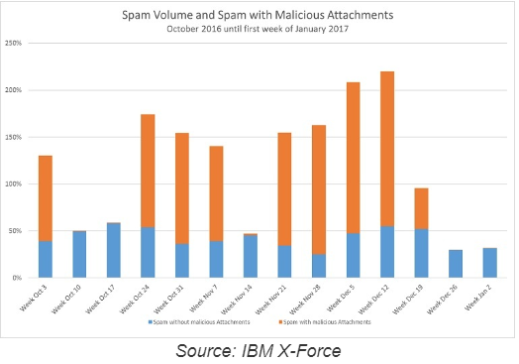
Necurs Botnet
Damages estimated at $6T by 2021!
Metamorphic and Resilient
DDoS capable (in 2017)
Ransomware Distribution (2012-2017)
Stock investment Spam (2017)
Social Engineering Attack
Kernel Mode-Rootkit
Notes:
https://securityintelligence.com/the-necurs-botnet-a-pandoras-box-of-malicious-spam/

Slide 6
Test Benches
Attack
Oracle VM VirtualBox:
Win10 (Mar 2019 Build)
Kali Linux (Jan 2019)
MS Excel/Word (Office 365)
Hardware:
I7 8700K @ 4.7GHz
8GB RAM (3200MHz)
IIT’s network (300Mbps)
Attack 1 - Macro-Enabled Live Phishing:
Linux
Requires web server
Requires obfuscation for effectiveness
Attack 2 - Macroless Embedded DoS:
Easy to implement
Easy to Hide

Slide 7
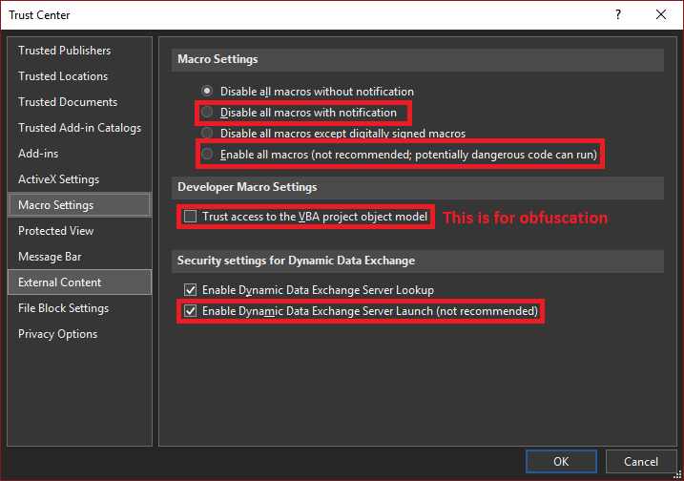
Issues
VBA Script Obfuscation not possible in MS Word
Restricted privileges prevent accessibility
User has to be easily duped
Only works well on old OS versions

Slide 8
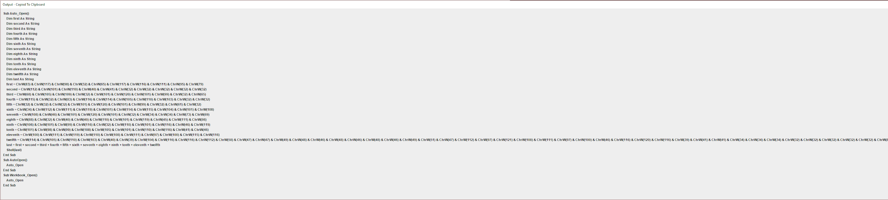
Current Implementation
Self-destructing (in Excel only)
Can change registry values (.docm only)
Automated Obfuscation in Java (casting int to char in C)
Keylogger developed in Python
Develop VBA scripts in macro editor
=MSEXCEL|'\..\..\..\Windows\System32\cmd.exe /c <exepath> <opt>'!_xlbgnm.<CELL NUM>
Notes:
Self destructs only if syntax errors updated on exec
https://null-byte.wonderhowto.com/how-to/create-obfuscate-virus-inside-microsoft-word-document-0167780/

Slide 9
This seems kind of familiar...

Slide 10
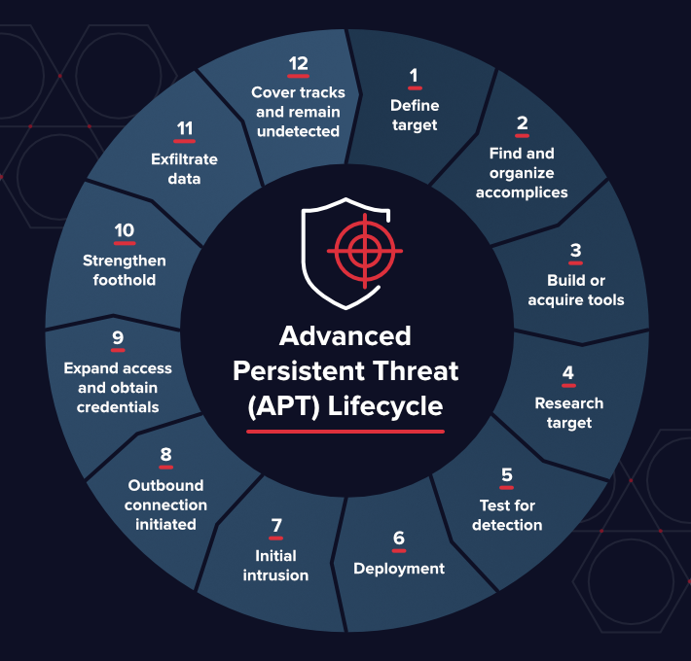
APT
Normally 6 steps
Modern attacks use 12
Great against:
AVs
Firewalls
Weak Networks
Notes:
The cyber criminal, or threat actor, gains entry through an email, network, file, or application vulnerability and inserts malware into an organization's network. The network is considered compromised, but not breached.
The advanced malware probes for additional network access and vulnerabilities or communicates with command-and-control (CnC) servers to receive additional instructions and/or malicious code.
The malware typically establishes additional points of compromise to ensure that the cyber attack can continue if one point is closed.
Once a threat actor determines that they have established reliable network access, they gather target access data, such as account names and passwords. Even though passwords are often encrypted, encryption can be cracked. Once that happens, the threat actor can identify and access data.
The malware collects data on a staging server, then exfiltrates the data off the network and under the full control of the threat actor. At this point, the network is considered breached.
Evidence of the APT attack is removed, but the network remains compromised. The cyber criminal can return at any time to continue the data breach.

Slide 11
Current Inferences/Questions
Why isn’t this patched yet?
Effectiveness of Social Engineering drastically affects success
Although simple, it has a striking similarity to Stuxnet but uses APT Anatomy as its Attack Process.
Notes:
APT - Advanced Persistent threats https://www.fireeye.com/current-threats/anatomy-of-a-cyber-attack.html

Slide 12
Future Project Improvements
Make exploit accessible in modern builds
Implement Necurs (without breaking the bench!)
Evaluate against modern malspam success ratio
Evaluate some more defensive techniques
Draw More Conclusions

Slide 13
References
https://www.fireeye.com/current-threats/anatomy-of-a-cyber-attack.html
https://null-byte.wonderhowto.com/how-to/create-obfuscate-virus-inside-microsoft-word-document-0167780/
https://redcanary.com/blog/microsoft-dde-exploit-email/
https://www.malware-traffic-analysis.net/2019/01/16/index.html
https://otx.alienvault.com/pulse/5a8d03bd54079f23240f15bc/
https://securityintelligence.com/the-necurs-botnet-a-pandoras-box-of-malicious-spam/

